Slide 1
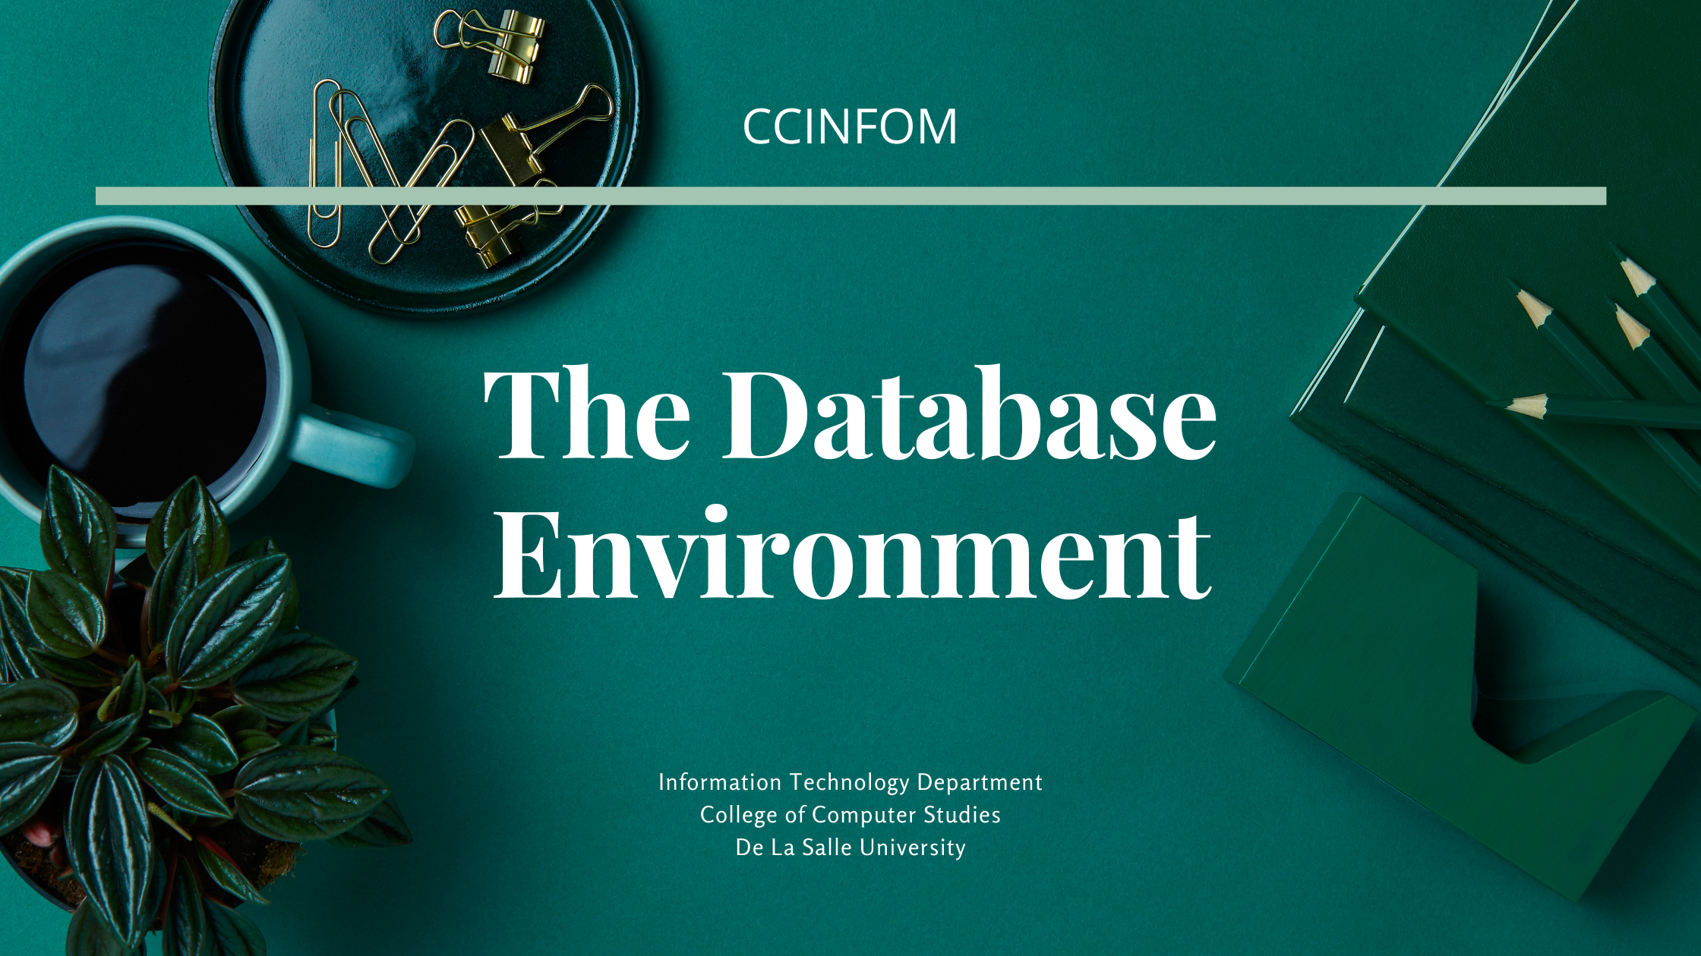

Notes:
Welcome to this session on the database environment, where the components and the roles of database system users will be presented. The database management system or DBMS and its functions will be further discussed.

Slide 2

Agenda
UNDERSTANDING THE FUNCTIONS OF THE DBMS
IDENTIFYING the COMPONENTS OF THE DATABASE ENVIRONMENT
DESCRIBING the ROLES OF USERS IN THE DATABASE ENVIRONMENT
Information Technology Department
De La Salle University
Notes:
This session aims at understanding the functions of the DBMS; identifying the different components of the database environment and the other elements that make up the components; and describing the roles of the different users in the database environment.

Slide 3


What did we cover in the last session?
File-based Systems
Database Systems
Database Application
Database Management System (DBMS)
Database
Database Tools (MySQL Workbench)
Information Technology Department
De La Salle University
Notes:
In the previous session, we covered two main topics: file-based systems & database systems. The different issues in file based systems were highlighted and how database systems solve such problems. Furthermore, the parts of database systems & how they work together were introduced, including the database application, the database management system, the database, & database tools.

Slide 4
What is a DBMS?
Database Management System
A software system (collection of several software) that is used to create, maintain, and provide controlled access to user databases
It manages the database for us and our software applications
Information Technology Department
De La Salle University
Notes:
Let’s begin with defining what a DBMS is.

Slide 5
What is a DBMS?
Database Management Functions
It maintains the database (collection of files that contains data)
It ensures that whatever we store are persistently stored in the database
It facilitates data manipulation (create, update, delete data) for us
It facilitates sharing of data to different users or database applications
It enforces rules to avoid duplication of data
It enforces rules to maintain referential integrity of our data
It enforces rules to maintain data consistency
Provides security for data
Information Technology Department
De La Salle University
Notes:
In the previous session, it was mentioned that the programming tasks of application developers are lightened up when it comes to coding data management functions, as it is the DBMS which does majority of the work.
The DBMS stores definitions of the data elements & their relationships. Any changes made in the database structure are also automatically recorded.
The DBMS also provides backup & data recovery to ensure data safety & integrity.
The DBMS transforms input data to conform to required data structures.
It facilitates sharing of data to different users or database applications through multiple access controls.
Security rules determine which users can access the database, which items each user can access, and which data operations the user can perform.

Slide 6


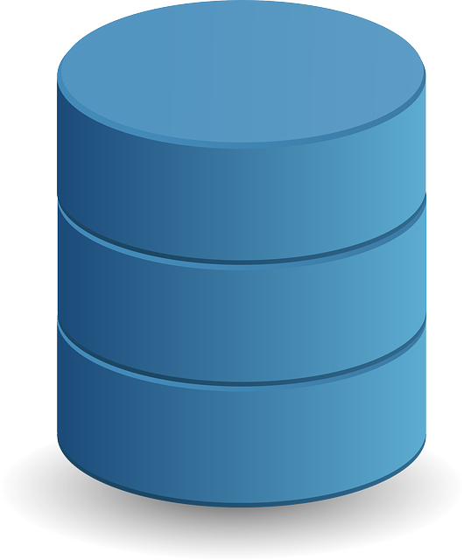

What happens inside the DBMS?
Database Management System
Database
Logical Representation of the Data inside the File System
File and File Operations Manager
A database is, technically, a set of files usually implemented using a binary file
SQL
Language Processor
Information Technology Department
De La Salle University
Notes:
Data are stored in a database, which is a set of files usually implemented using a binary file. To avoid the aforementioned issues with directly accessing data & information from files, instructions from application programs would have to go through the DBMS.
Instructions are written in SQL, which are received by the DBMS and parsed through the language processor.
From the language processor, the DBMS interprets the logical representation of the data inside the file system. This logical representation provides information on how the database is structured, as well as what and how the data is stored in it. There is also the file & file operations manager component, to carry out update & retrieval data functions.

Slide 7

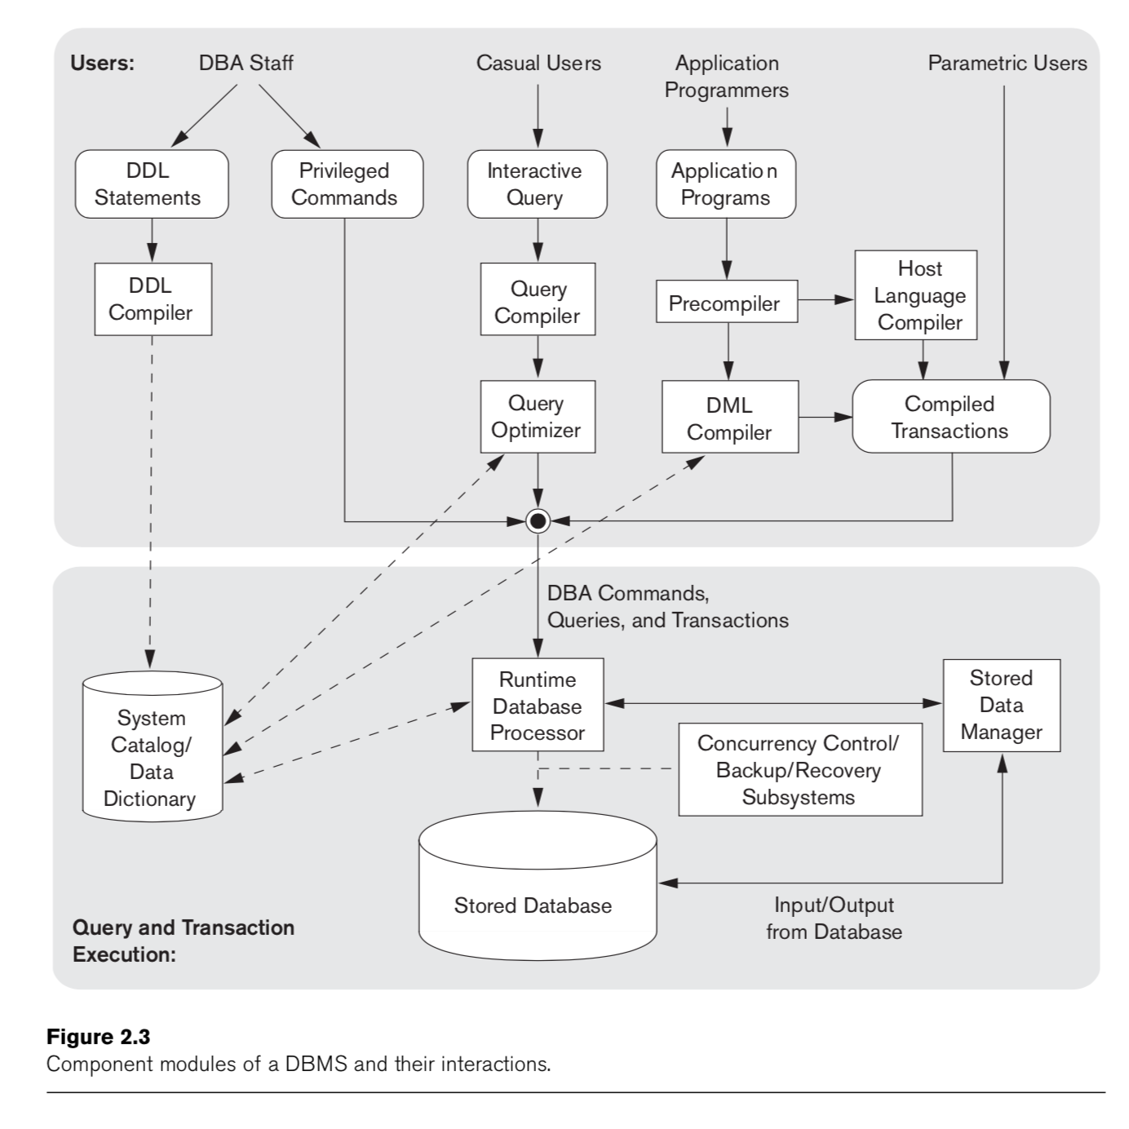


A more detailed view of what is inside
Notes:
We can see here a more detailed view of what is inside the DBMS and where instructions in SQL are used.
SQL plays an integral role in each of these components.
This section shows the different compilers that make up the language processor, which outputs DBA commands, queries, and transactions.
SQL is used in the DDL or data definition language for creating the structure of database objects.
The data dictionary in the DBMS stores metadata which provides information on data relationships & characteristics. Moreover, any changes in the physical database structure are stored in the data dictionary, eliminating the need to modify programs that make use of such database.
SQL is used by other programs for building reports in order to access the data from the database.
In database administration, SQL is utilized for controlling resources, facilitating backup & recovery from failures, and providing data security through the data control languages or DCLs.

Slide 8
The ANSI-SPARC Architecture
Information Technology Department
De La Salle University
Notes:
In the early 1970s, the American National Standards Institute (ANSI) Standards Planning & Requirements Committee (SPARC) defined a framework for data modeling based on degrees of abstraction, which became known as the ANSI-SPARC Architecture.
Let’s take a look at this example on how data is organized and viewed in a database system.
As previously mentioned, a database is still a collection or a set of files. These files are located in directories & folders; they have file names, file types, data structures, and some form of encryption.
These data are represented in relational tables in the database. In this example, we have the student, course, and enrollment tables as opposed to files in an earlier illustration of a file-based system for enrollment.
Various users of the application program can see different versions of the data contained in the tables depending on what they need. For example, the registrar can view a master list of all students in the University; they can view all course offerings; and also view the students’s grades in each course.
Department chairs can view class lists for different courses; filter the list of students enrolled in a particular program; and take a look at existing course information.
Faculty can also view the course information and the list of students enrolled in the course, like those in a class list.

Slide 9
The ANSI-SPARC Architecture
Directories and Folders
Filename
File type
Data structure
Linked List
Struct type
Encryption
Information Technology Department
De La Salle University
Notes:
As previously mentioned, a database is still a collection or a set of files. These files are located in directories & folders; they have file names, file types, data structures, and some form of encryption.

Slide 10
The ANSI-SPARC Architecture
Relational Tables as seen as a whole database
Directories and Folders
Filename
File type
Data structure
Linked List
Struct type
Encryption
Information Technology Department
De La Salle University
Notes:
These data are represented in relational tables in the database. In this example, we have the student, course, and enrollment tables as opposed to files in an earlier illustration of a file-based system for enrollment.

Slide 11
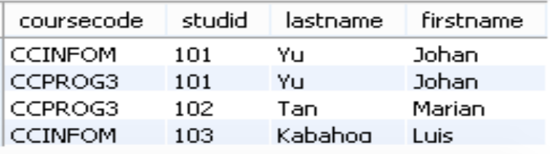
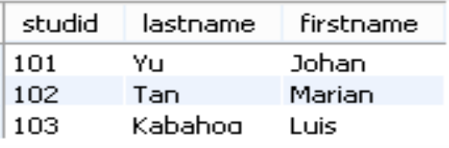
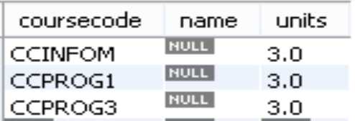
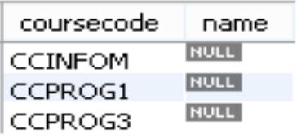
The ANSI-SPARC Architecture
As seen by Registrar
Relational Tables as seen as a whole database
Directories and Folders
Filename
File type
Data structure
Linked List
Struct type
Encryption
As seen by Department Chair
As seen by Faculty
Information Technology Department
De La Salle University
Notes:
Various users of the application program can see different versions of the data contained in the tables depending on what they need. For example, the registrar can view a master list of all students in the University; they can view all course offerings; and also view the students’s grades in each course.
Department chairs can view class lists for different courses; filter the list of students enrolled in a particular program; and take a look at existing course information.
Faculty can also view the course information and the list of students enrolled in the course, like those in a class list.

Slide 12
The ANSI-SPARC Architecture
As seen by Registrar
Relational Tables as seen as a whole database
Directories and Folders
Filename
File type
Data structure
Linked List
Struct type
Encryption
As seen by Department Chair
As seen by Faculty
Information Technology Department
De La Salle University
Notes:
This example helps us visualize the three levels of abstraction as indicated in the ANSI-SPARC Architecture.

Slide 13
The ANSI-SPARC Architecture
Registrar VIEW
VIEW of the entire Database
Internal VIEW of the entire Database
Department Chair VIEW
Faculty VIEW
External View
Conceptual View
Internal View
The DBMS maps each external view to its corresponding conceptual view, and the conceptual view to its internal view
Information Technology Department
De La Salle University
Notes:
From the previous example, we can see the following different views:
An internal view of the entire database
The view of the entire database
And the individual user views
These correspond to the
Internal View: DBMS View
Conceptual View: Database Designer’s View
External View: End User’s View

Slide 14
The ANSI-SPARC Architecture
Registrar VIEW
VIEW of the entire Database
Internal VIEW of the entire Database
Department Chair VIEW
Faculty VIEW
External View
Conceptual View
Internal View
The users/applications simply see their own external view
Information Technology Department
De La Salle University
Notes:
Based on what users see on screen from the application program, it may seem that different files are being presented depending on what information or part of the system is being viewed. There are no individual, separate files for different users/applications. The user/application simply sees its own external view of the data & information coming from the database.

Slide 15
The ANSI-SPARC Architecture
Registrar VIEW
VIEW of the entire Database
Internal VIEW of the entire Database
Department Chair VIEW
Faculty VIEW
External View
Conceptual View
Internal View
The database will do the mapping to the actual data stored physically as files
Information Technology Department
De La Salle University

Slide 16


What DBMS are we going to use? To learn the basics of SQL and databases
DBMS
DB
SQL
An interactive tool to communicate and give instructions to DBMS using a language called SQL.
MySQL Community Edition 8.0
MySQL
Relational Databases
One of the leading and widely-used relational DBMS in the Industry, owned by Oracle Corporation
Information Technology Department
De La Salle University
Notes:
What DBMS are we going to use in this course to learn the basics of SQL & databases?
For the DBMS, we are going to use MySQL Community Edition 8.0. It is …
This DBMS is creates and links to MySQL relational databases.
We will also be using a DBMS tool called MySQL Workbench, which is…
…that stands for Structured Query Language.

Slide 17
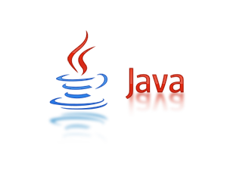

What DBMS are we going to use? To learn the basics of applications development using databases
DBMS
DB
Human Interaction
Processing
SQL
MySQL Community Edition 8.0
MySQL
Relational Databases
One of the leading and widely-used relational DBMS in the Industry, owned by Oracle Corporation
Information Technology Department
De La Salle University
Notes:
How about the other tools to learn the basics of applications development using databases?
For the human interaction or the user interface, we will be using JSP and then Java for the functions of the application programs and writing the SQL instructions.
The links to the installers for these tools have already been posted in AnimoSpace at the start of the term. It is highly recommended that you already install them in order to have enough time to resolve installation problems before we use them in class.

Slide 18
The CON part of using DBMS & Databases
Expensive
Requires frequent update and maintenance
Requires a database administrator (DBA) to maintain the DB
Information Technology Department
De La Salle University
Notes:
Despite the numerous advantages of databases & DBMSs, they also have their down side.
First is that they can be expensive. Database systems can require sophisticated IT resources and highly-skilled technical personnel. The cost of resource maintenance is also high. Maintenance does not just refer to the maintenance of hardware & software. Training, licensing, and IT audit costs are also part of database systems maintenance, which are often overlooked.
Second, they require frequent update & maintenance. When DBMS vendors upgrade their products, such as the release of new software versions, hardware upgrade may also be necessary. Additional resources will also be needed to train database users & administrators given these new features.
Third, a database administrator is necessary to maintain the database. Although modern database systems offload application developers with programming tasks, organizations cannot entirely rely on them nor on the database designers when it comes to the management & maintenance of the DBMS & the databases used. DBAs have a different skill set, including knowledge about DBMS vendors.

Slide 19
The DBMS is a part of something bigger
The Database Environment
It shows the components that affect data management and the database itself
It explains how the machine and human components affect each other in terms of data management
Information Technology Department
De La Salle University
Notes:
Hardware, software, data, procedures, & people make up the database environment
It explains how the machine & human components affect each other in terms of data management, with the data serving as the bridge that connects them.
We will be expounding on these components in the succeeding slides.

Slide 20
Database Environment Components
Hardware
Physical Devices that will be involved in Data Management
Servers, Computing Devices of Users
Software
Operating System the DBMS and Database will be working with
DBMS Software
Data
Data to be managed
People
Procedure
Applications that will be developed
Software Tools that will be used by users
The different clients of the database system
The different technical users that will ensure that the database system is what clients need
Set of tasks, functions, processes of clients that will affect data management
Set of tasks, functions, processes of technical users to ensure that the database system is what clients need
Information Technology Department
De La Salle University
Notes:
Hardware: Among others, this includes servers, storage device, network devices, printers, and computing devices of users such as desktops, tablets, & other workstations.
Software: Other software tools or utility software to access and manipulate data in the DBMS & to manage the application environment. Most of these tools have graphical user interfaces (or GUI) to easily perform database operations.
Data: Of course, the data to be managed, including determining which data is needs and how to organize it based on the requirements.
People: The people component includes all the users or clients of the database system, having different & complementary job roles or functions in the system, from end users to system administrators. We will discuss more about these people in a while.
Procedure: Ultimately, procedures play an important role in an organization as these are the source of standards by which transactions are performed.

Slide 21
Database Environment Components
Hardware
Physical Devices that will be involved in Data Management
Servers, Computing Devices of Users
Software
Operating System the DBMS and Database will be working with
DBMS Software
Data
Data to be managed
People
Procedure
Applications that will be developed
Software Tools that will be used by users
The different clients of the database system
The different technical users that will ensure that the database system is what clients need
Set of tasks, functions, processes of clients that will affect data management
Set of tasks, functions, processes of technical users to ensure that the database system is what clients need
Information Technology Department
De La Salle University
Notes:
Hardware: Among others, this includes servers, storage device, network devices, printers, and computing devices of users such as desktops, tablets, & other workstations.
Software: There are also other software tools or utility software to access and manipulate data in the DBMS & to manage the application environment. Most of these tools already have graphical user interfaces (or GUI) to easily perform database operations.
Data: Of course, the data to be managed, including determining which data is needs and how to organize it based on the requirements.
People: The people component includes all the users or clients of the database system, having different & complementary job roles or functions in the system, from end users to system administrators. We will discuss more about these people in a while.
Procedure: Ultimately, procedures play an important role in an organization as these are the source of standards by which transactions are performed.

Slide 22
Database Environment Components
Hardware
Physical Devices that will be involved in Data Management
Servers, Computing Devices of Users
Software
Operating System the DBMS and Database will be working with
DBMS Software
Data
Data to be managed
People
Procedure
Applications that will be developed
Software Tools that will be used by users
The different clients of the database system
The different technical users that will ensure that the database system is what clients need
Set of tasks, functions, processes of clients that will affect data management
Set of tasks, functions, processes of technical users to ensure that the database system is what clients need
Information Technology Department
De La Salle University
Notes:
Data: Of course, the data to be managed is the most essential component, including determining which data is needed and how to organize it based on the requirements.
People: The people component includes all the users or clients of the database system, having different & complementary job roles or functions in the system, from end users to system administrators. We will discuss more about these people in a while.
Procedure: Ultimately, procedures play an important role in an organization as these are the source of standards by which transactions are performed.

Slide 23
Database Environment Components
Hardware
Physical Devices that will be involved in Data Management
Servers, Computing Devices of Users
Software
Operating System the DBMS and Database will be working with
DBMS Software
Data
Data to be managed
People
Procedure
Applications that will be developed
Software Tools that will be used by users
The different clients of the database system
The different technical users that will ensure that the database system is what clients need
Set of tasks, functions, processes of clients that will affect data management
Set of tasks, functions, processes of technical users to ensure that the database system is what clients need
Information Technology Department
De La Salle University
Notes:
People: Next, the people component includes all the users or clients of the database system, having different & complementary job roles or functions in the system, from end users to system administrators. We will discuss more about these people in a while.
Procedure: Ultimately, procedures play an important role in an organization as these are the source of standards by which transactions are performed.

Slide 24
Database Environment Components
Hardware
Physical Devices that will be involved in Data Management
Servers, Computing Devices of Users
Software
Operating System the DBMS and Database will be working with
DBMS Software
Data
Data to be managed
People
Procedure
Applications that will be developed
Software Tools that will be used by users
The different clients of the database system
The different technical users that will ensure that the database system is what clients need
Set of tasks, functions, processes of clients that will affect data management
Set of tasks, functions, processes of technical users to ensure that the database system is what clients need
Information Technology Department
De La Salle University
Notes:
Procedure: Finally, we have procedures which are tasks... Procedures also include the tasks…
Ultimately, procedures play an important role in an organization as these are the sources of standards by which transactions are performed.

Slide 25
Database Environment Components
Hardware
Physical Devices that will be involved in Data Management
Servers, Computing Devices of Users
Software
Operating System the DBMS and Database will be working with
DBMS Software
Data
Data to be managed
People
Procedure
Applications that will be developed
Software Tools that will be used by users
The different clients of the database system
The different technical users that will ensure that the database system is what clients need
Set of tasks, functions, processes of clients that will affect data management
Set of tasks, functions, processes of technical users to ensure that the database system is what clients need
Information Technology Department
De La Salle University
Notes:
From these components & descriptions, those highlighted will be covered in our information management course. All components will be touched, except for hardware.
For the software component, you have the database application project.
The data component also covers conceptual & logical data modeling.
We also have to consider the different users of the database applications & the corresponding data management functions that they need to perform.
This course does not include the manipulation of hardware components used in the database system.

Slide 26
Questions to Ponder
How do you think each component affects data management?
How do you think each component affects each other?
 | Hardware | Software | Data | People | Procedure
Hardware
Software
Data
People
Procedure
Information Technology Department
De La Salle University
Notes:
Let’s take a quick reflection on what we have learned so far. Also using your existing knowledge about the database environment components, here are some questions to ponder.
How does the DBMS software & database application affect the hardware that needs to be acquired or vice versa? Which should be prioritized between hardware or software?
How do implemented procedures affect the performance of different database system users?
What will happen if the data requirements collected is incomplete or if the database contents are designed inappropriately?
You can pause this presentation to think about your answers to these questions before proceeding to the next slide. It will help if you take note of your thoughts, so you can share them in the next class discussion regarding this topic.

Slide 27
The Different People in the Database Environment
Non-Technical Users
End-Users
Technical Users
Database Administrator
System Analyst
Database Architect / Designer
Application Developer
System Administrator
Information Technology Department
De La Salle University
Notes:
Going back to the people component or the different people involved in the database environment. They can be categorized as non-technical & technical users.
On one hand, the non-technical users include end users or clients which are the people whom the application programs are intended for.
On the other hand, technical users are the database administrators, system administrators, database architects or designers, systems analysts, and application developers.

Slide 28
The Different People in the Database Environment
Development
Systems Analyst
Database Architects/Designers
Application Developer
Systems Analyst identifies requirements that will be the basis of the database system
Database Architects / Designers designs the database
Application Developer programs the application to its intended use and functionality
Deployment
System Administrators
Database Administrators
Database Administrators manage the DBMS and the Database
System Administrators manage the Database System, and the other infrastructure where the Database System is deployed on
Information Technology Department
De La Salle University
Notes:
So what are the differences in these roles?
The technical users can be further classified according to their role in the systems development lifecycle.
Those who are involved in the development phase are the systems analyst, database designer, and application developer.
A systems analyst identifies the user and organization requirements that will be the basis in designing the functions of the database system.
Database Architects/Designers design the database structure in order to help application programmers effectively develop a functional database environment.
Application developers or programmers create the application based on its intended use & functionality.
Those who are involved in the deployment phase are the system & database administrators.
Database Administrators or DBAs manage the DBMS & the database and ensure that they are working properly.
System Administrators oversee the database system’s general operations. They manage the database system and the other infrastructure where the database system is deployed on.

Slide 29
Which degree program develops each technical user?
TECHNICAL USERS | BSIT | BSIS | BSCS
Database Administrator
System Administrator
Systems Analyst
Database Architect/Designer
Application Developer
Information Technology Department
De La Salle University

Slide 30
Which degree program develops each technical user?
TECHNICAL USERS | BSIT | BSIS | BSCS
Database Administrator | X
System Administrator | X
Systems Analyst |  | X
Database Architect/Designer | X | X | X
Application Developer | X | X | X
Information Technology Department
De La Salle University
Notes:
All CCS programs develop skills for roles as a database architect or designer and as an application developer.
BSIT students are further trained for skills in database & system administration, while BSIS students also develop their skills in systems analysis.

Slide 31
References
Coronel, C. & Morris, S. (2017). Database systems: design, implementation, and management, 13th ed. Boston, MA: Cengage Learning.
Umanath, N. & Scamell, R. (2015). Data modeling & database design, 2nd ed. Boston, MA: Cengage Learning.
Information Technology Department
De La Salle University

Slide 32
Questions?
PLEASE POST YOUR QUESTIONS IN THE DISCUSSION BOARD CREATED FOR THIS TOPIC.
Information Technology Department
De La Salle University
Notes:
If there is an AnimoSpace discussion board created in your class for this topic, kindly post your questions there in order for the rest of the class to see the replies. Otherwise, you may reach out to your instructor through the communication channels provided.

Slide 33

Notes:
That is the end of this session. Please check the AnimoSpace course for your section and keep yourself updated regarding other relevant materials or tasks on this topic. Thank you and keep safe always.

